Slide 1
Example quadrats

Slide 2
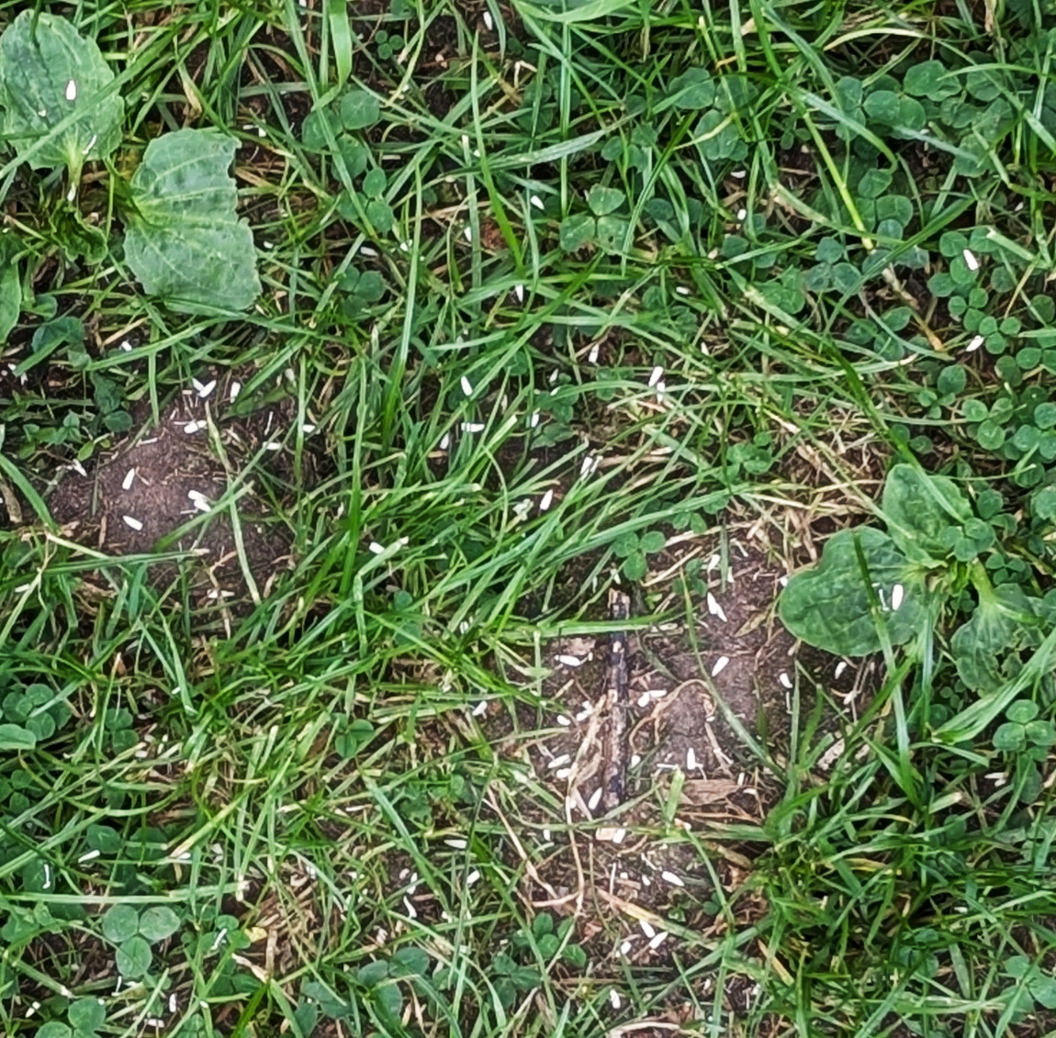
Quadrat 1
 | Number of squares
Grass
Clovers
Greater plantain
Broad-leaved dock
Common daisy
Dandelion
Common mouse-ear
Yarrow
Yellow rattle

Slide 3
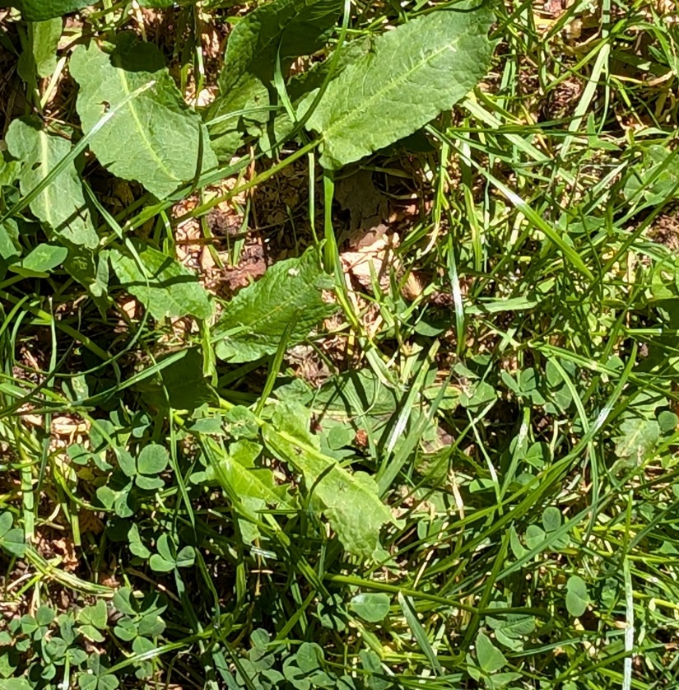
Quadrat 2
 | Number of squares
Grass
Clovers
Greater plantain
Broad-leaved dock
Common daisy
Dandelion
Common mouse-ear
Yarrow
Yellow rattle

Slide 4
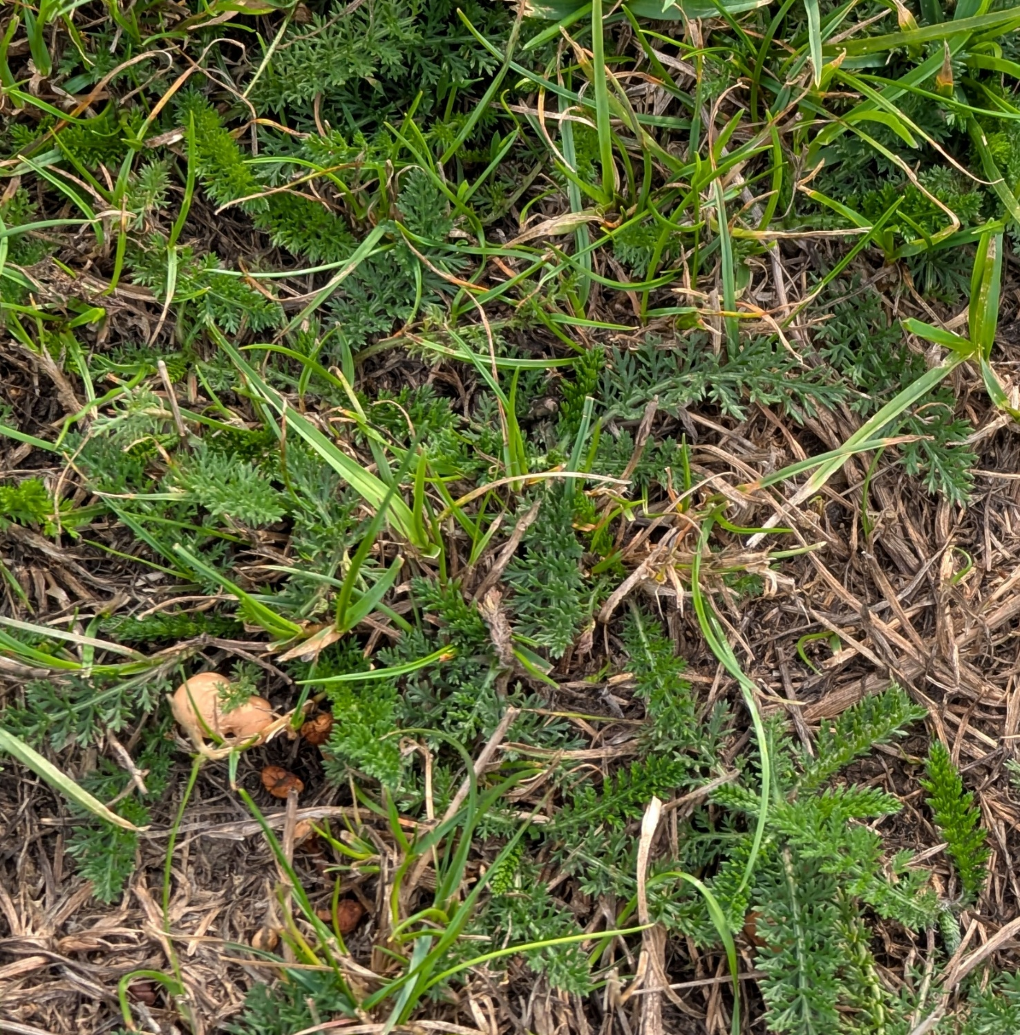
Quadrat 3
 | Number of squares
Grass
Clovers
Greater plantain
Broad-leaved dock
Common daisy
Dandelion
Common mouse-ear
Yarrow
Yellow rattle

Slide 5
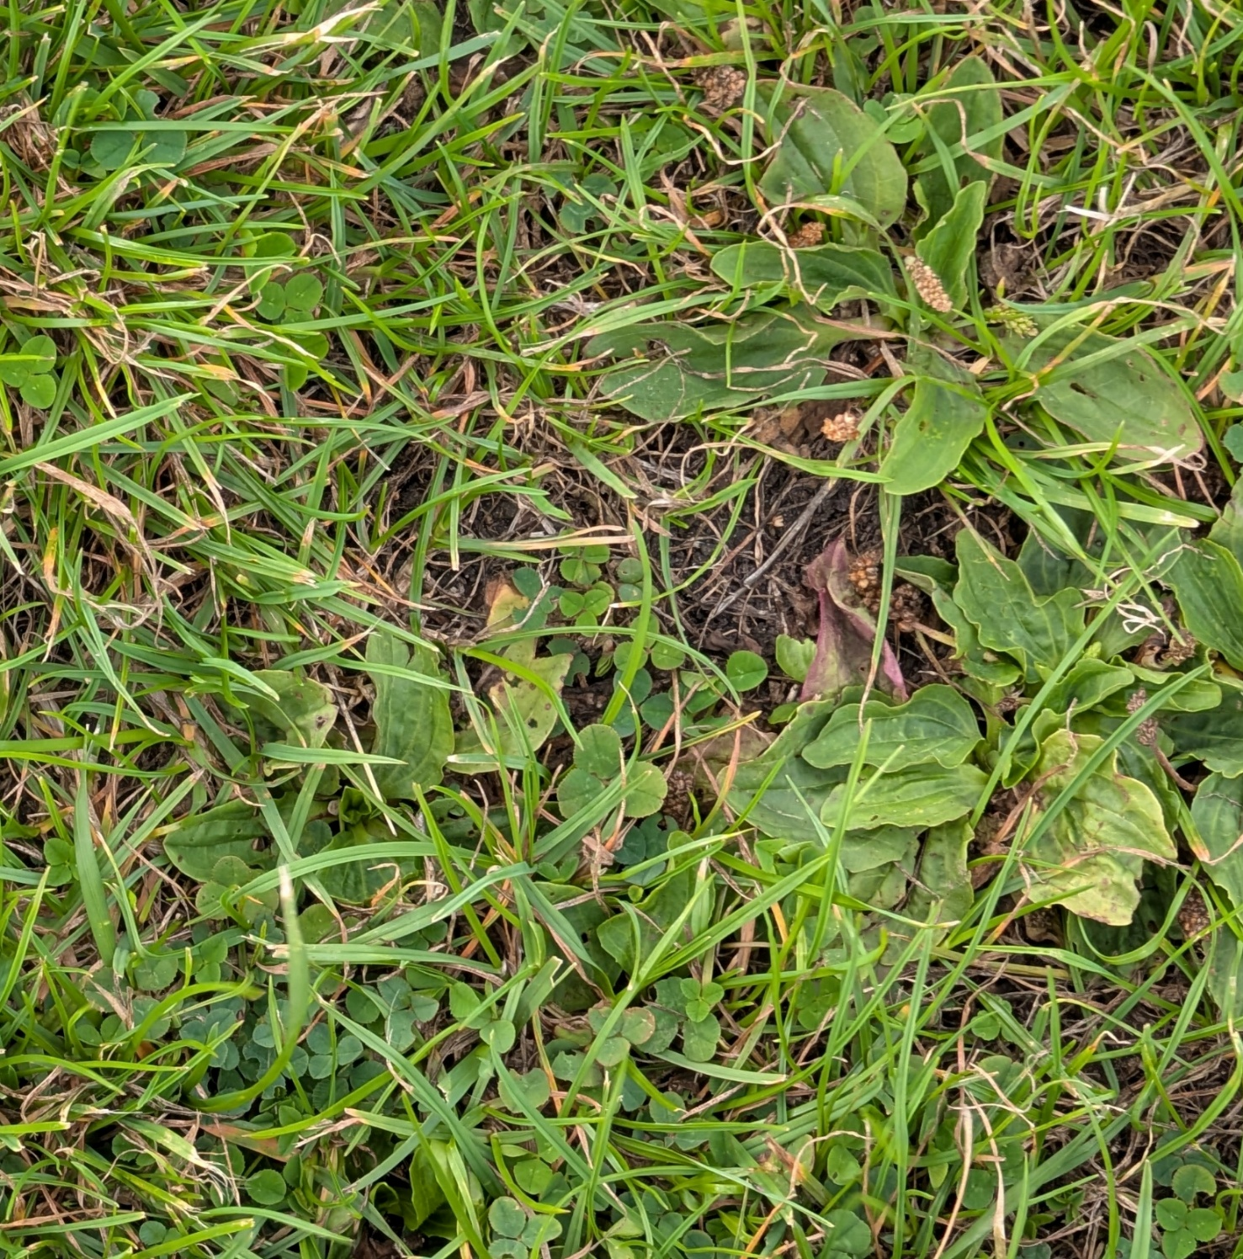
Quadrat 4
 | Number of squares
Grass
Clovers
Greater plantain
Broad-leaved dock
Common daisy
Dandelion
Common mouse-ear
Yarrow
Yellow rattle

Slide 6
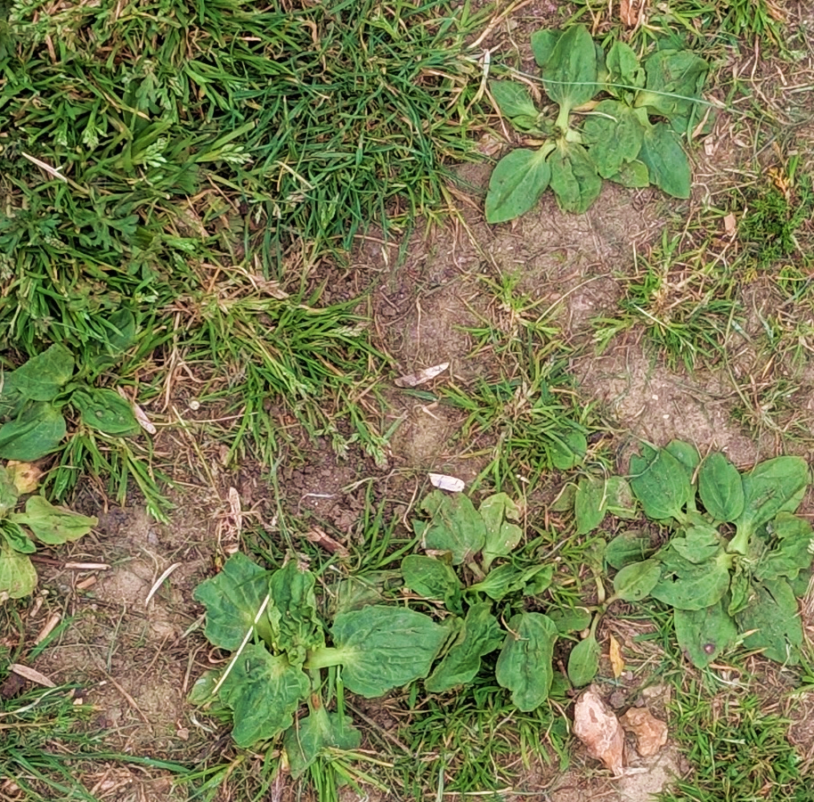
Quadrat 5
 | Number of squares
Grass
Clovers
Greater plantain
Broad-leaved dock
Common daisy
Dandelion
Common mouse-ear
Yarrow
Yellow rattle

Slide 7
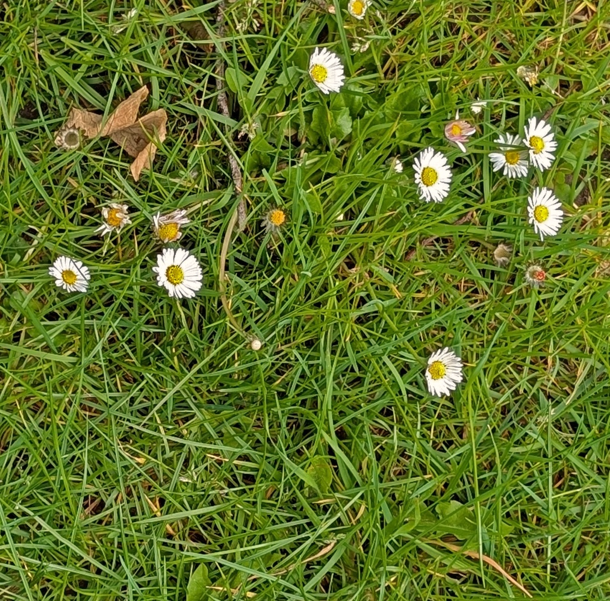
Quadrat 6
 | Number of squares
Grass
Clovers
Greater plantain
Broad-leaved dock
Common daisy
Dandelion
Common mouse-ear
Yarrow
Yellow rattle

Slide 8
Answers and interpretations

Slide 9
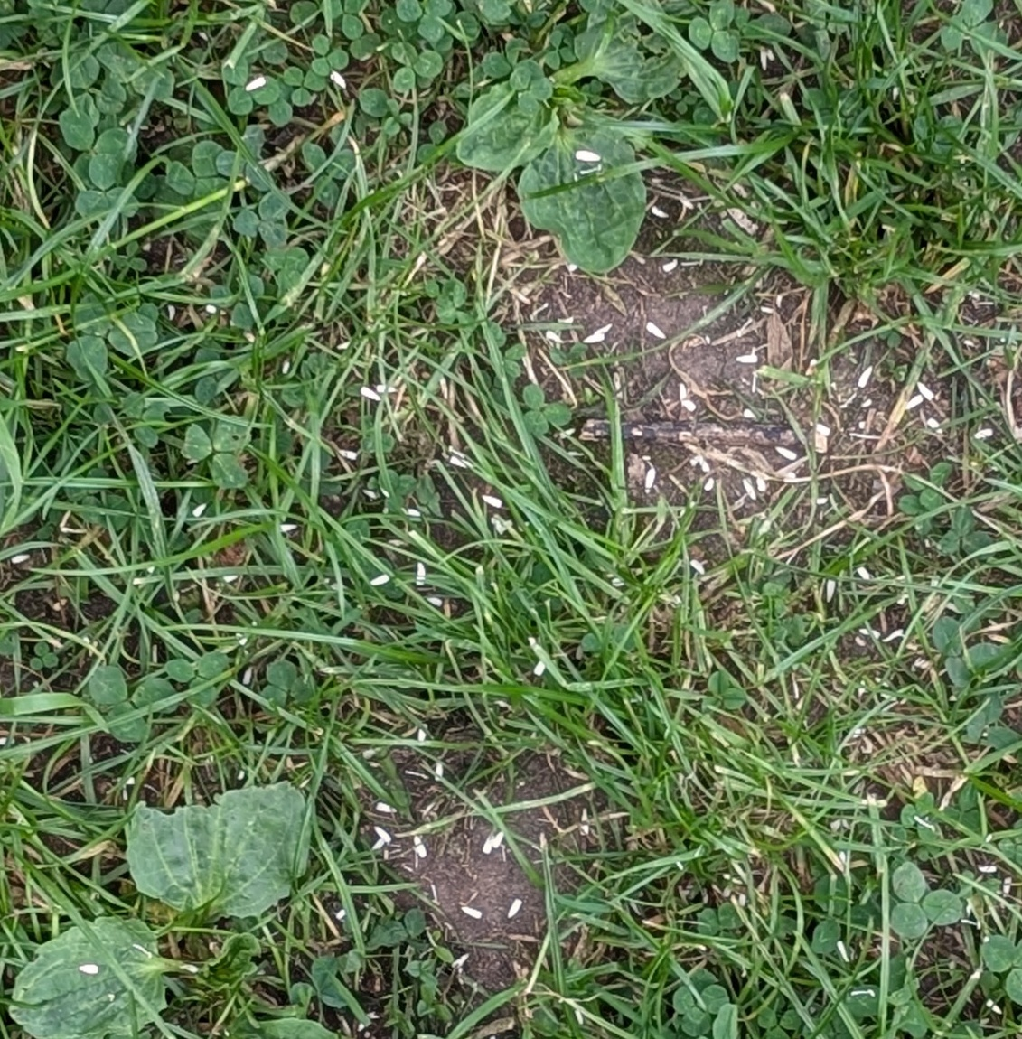
Quadrat 1 answers
 | Number of squares
Grass | 12
Clovers | 9
Greater plantain | 2
Broad-leaved dock | 0
Common daisy | 0
Dandelion | 0
Common mouse-ear | 0
Yarrow | 0
Yellow rattle | 0
Notes:
Grass is relatively short, and greater plantains are growing flat to the ground, suggesting the area is regularly cut.
Greater plantain and bare patches indicate the soil is compacted. This area is probably walked on often.

Slide 10
Quadrat 2 answers
 | Number of squares
Grass | 10
Clovers | 7
Greater plantain | 0
Broad-leaved dock | 5
Common daisy | 0
Dandelion | 0
Common mouse-ear | 0
Yarrow | 0
Yellow rattle | 0
Notes:
Dock indicates soil nutrient levels might be high.
Grass is longer, dock leaves some dock leaves look damaged, others don’t. This area is probably not very regularly mown or walked on.
This might be a good area to add more grassland plants and boost biodiversity. However, the potentially high nutrient levels mean some slower-growing plants might not be able to compete with the grass.

Slide 11
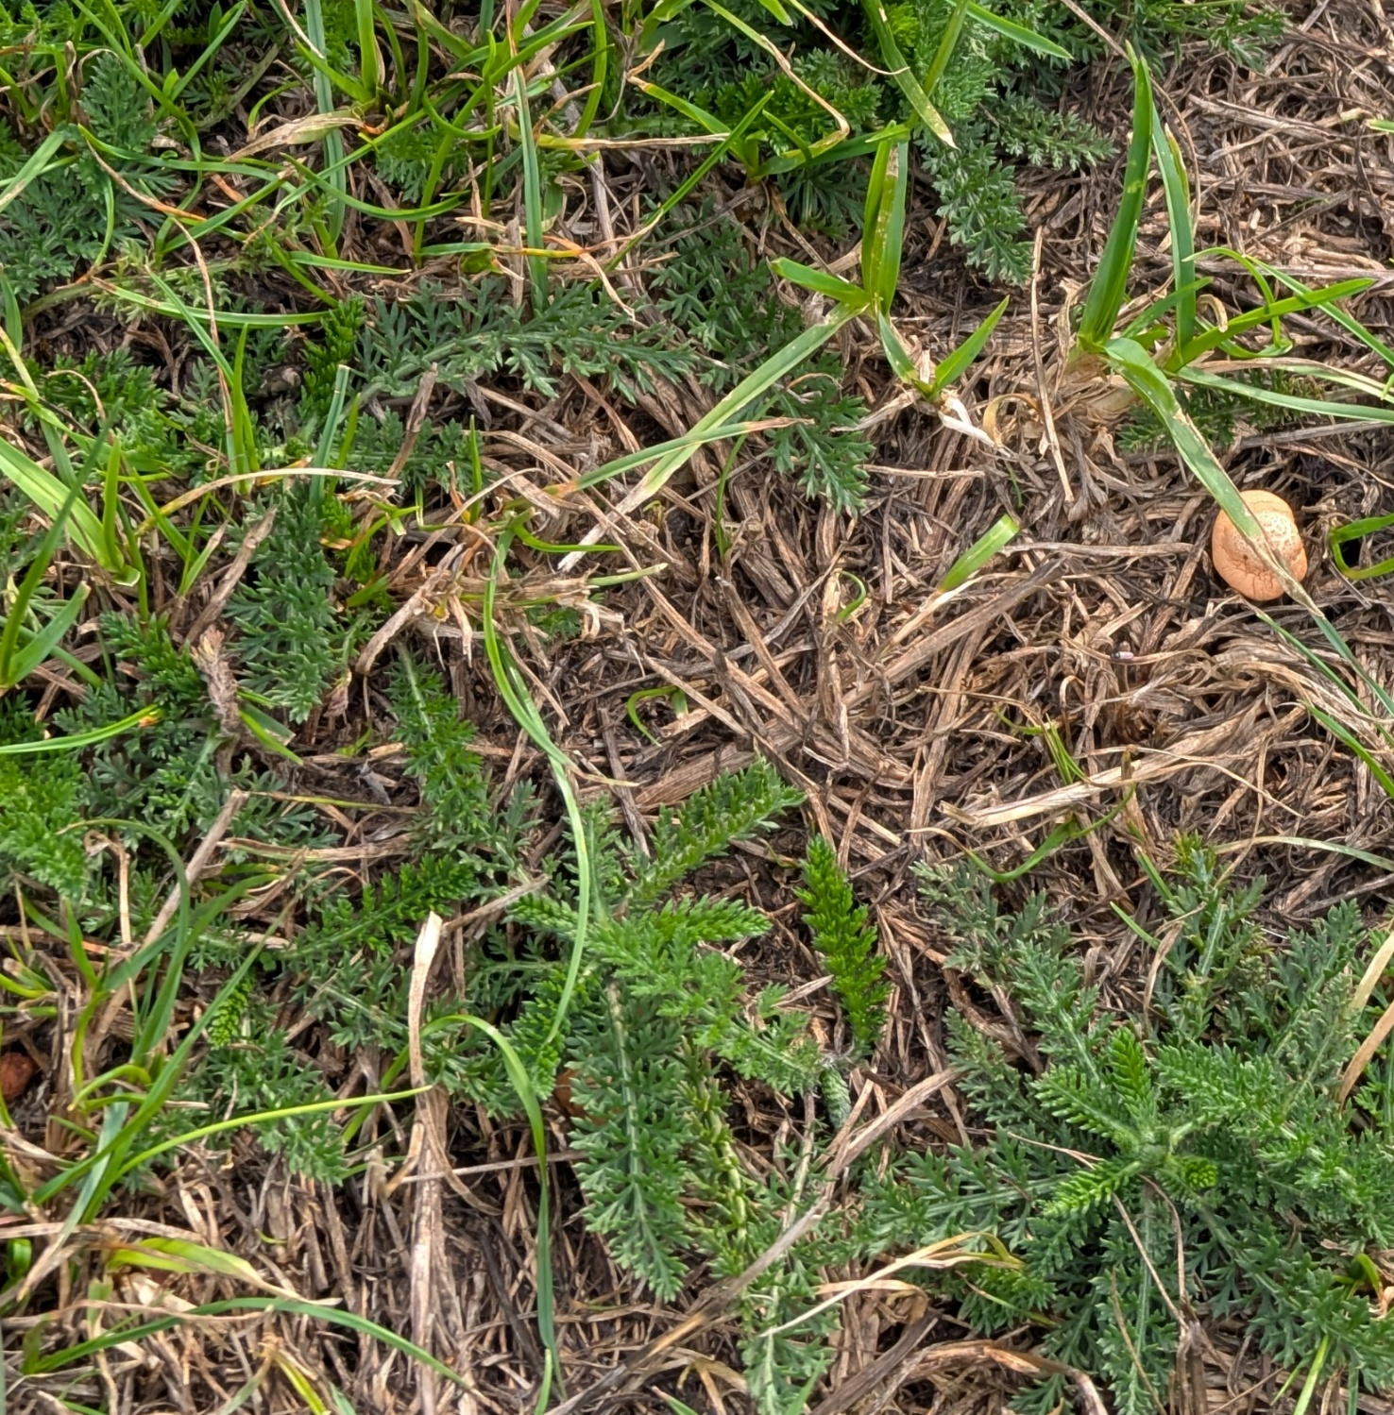
Quadrat 3 answers
 | Number of squares
Grass | 16
Clovers
Greater plantain
Broad-leaved dock
Common daisy
Dandelion
Common mouse-ear
Yarrow | 10
Yellow rattle
Notes:
Short yarrow leaves and grass indicate the area is likely to be frequently mown.
Lots of dry yellow grass might be an indication of compaction, but it may also be due to dry weather. Information from other survey quadrats might give a clearer picture of the conditions.

Slide 12

Quadrat 4 answers
 | Number of squares
Grass | 15
Clovers | 9
Greater plantain | 5
Broad-leaved dock | 0
Common daisy | 0
Dandelion | 0
Common mouse-ear | 0
Yarrow | 0
Yellow rattle | 0
Notes:
Grass is relatively short, and greater plantains are growing flat to the ground, suggesting the area is regularly cut.
Greater plantain and bare patches indicate the soil is compacted. This area is probably walked on often.

Slide 13
Quadrat 5 answers
 | Number of squares
Grass | 11
Clovers | 0
Greater plantain | 8
Broad-leaved dock | 0
Common daisy | 0
Dandelion | 0
Common mouse-ear | 0
Yarrow | 0
Yellow rattle | 0
Notes:
Grass is relatively short, and greater plantains are growing flat to the ground, suggesting the area is regularly cut.
Greater plantain and bare patches indicate the soil is compacted. This area is probably walked on often.
Greater plantain and few other species might indicate low soil nutrients.
This might not be a good area to add additional plants because people frequently use it as a path.

Slide 14
Quadrat 6 answers
 | Number of squares
Grass | 16
Clovers
Greater plantain
Broad-leaved dock
Common daisy | 7
Dandelion | 3
Common mouse-ear
Yarrow
Yellow rattle
Notes:
Dandelion and daisy indicate soil might be compacted. The area might be regularly walked on. But not so much that the plants have been trampled to death, leaving bare soil.
Dandelion indicated nutrient levels might be high.

